Slide 1

Inheritance
By Min Thet Naing

Slide 2
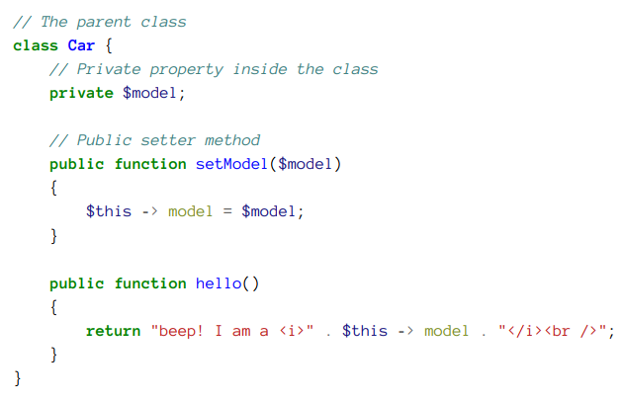
By Min Thet Naing

Slide 3
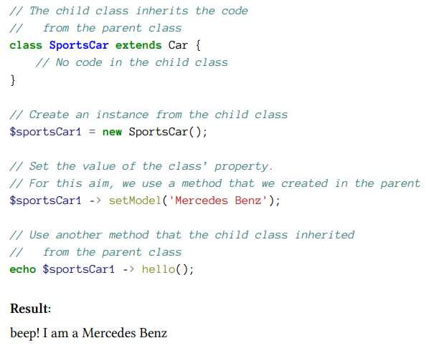
By Min Thet Naing

Slide 4
Child class can have its own methods and properties
By Min Thet Naing

Slide 5
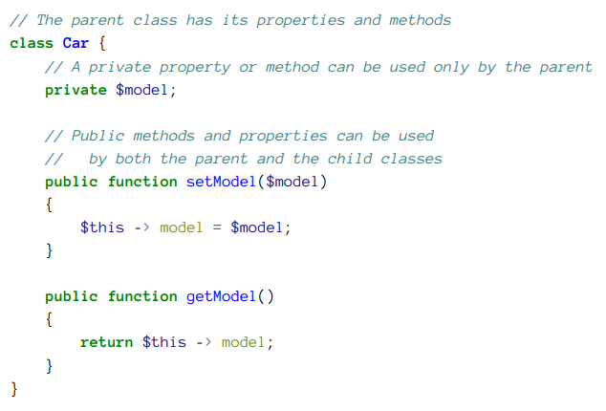
By Min Thet Naing

Slide 6
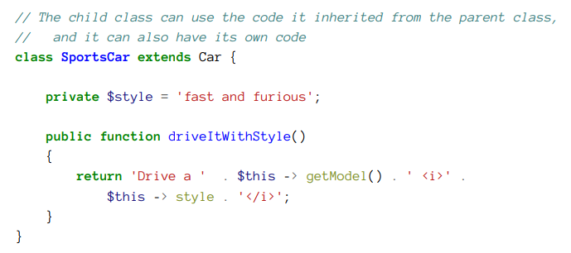
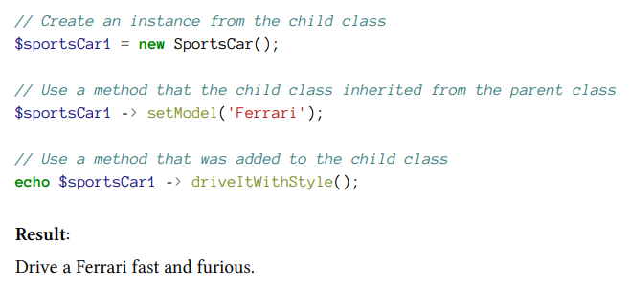
By Min Thet Naing

Slide 7
The protected access control modifier
By Min Thet Naing

Slide 8
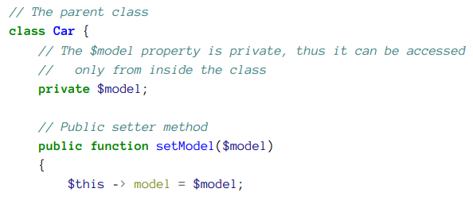
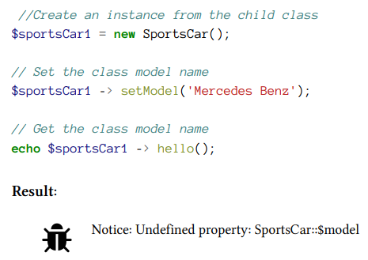
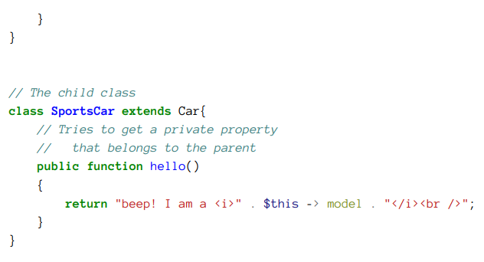
By Min Thet Naing

Slide 9
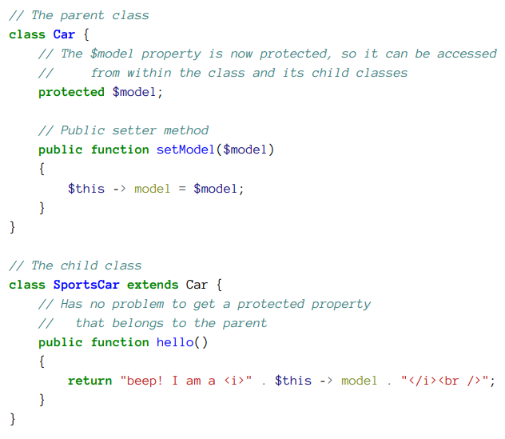
By Min Thet Naing

Slide 10
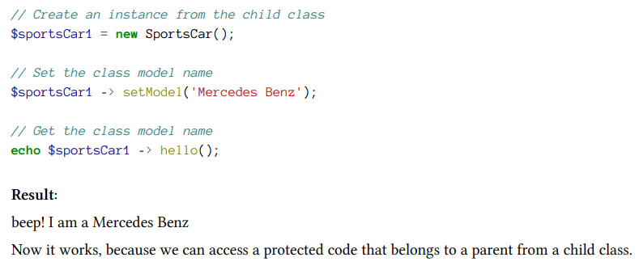
By Min Thet Naing

Slide 11
The parent’s properties and methods can override in the child class
By Min Thet Naing

Slide 12
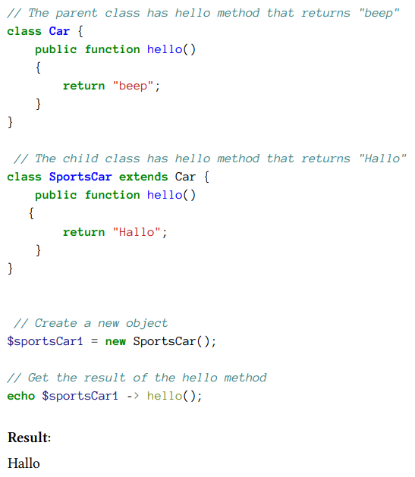
By Min Thet Naing

Slide 13
The final keyword
By Min Thet Naing

Slide 14
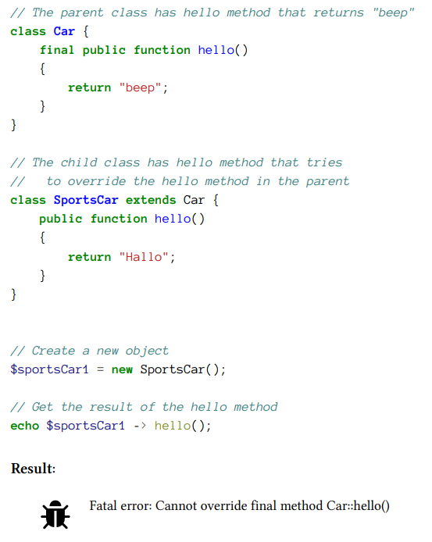
By Min Thet Naing

